Slide 1

Innovus Capital
Problem Statement

Slide 2
Project overview:
As a new Fintech startup company using AI algorithm to automate public equity research report, Innovus Capital have established a functional model and website. We are now seeking to expand our market outreach. However, due to constrained budget, we need to look for investors interested in our company and be cautious about cost management.
The challenge is to find the potential investors and efficient marketing strategies.
Deliverables:
The outcome of the project should include, but not be limited to:
2-3 investors (individual or institution) that will be interested and why they might be interested.
2-3 marketing strategies. Detailed description of how they should be executed, a breakdown of budget estimation and the expected outcome of the respective strategies.
A holistic report the best strategy of Innovus Capital and why, include any additional information and recommendations through having analyzed the findings from the above tasks.

Slide 3
01 About Us

Slide 4
ABOUT US
Who We Are
Fintech Start-up, using AI algorithm to automate public equity research report
Our Mission: Make quality and affordable investment recommendations available to retail investors like you and me
Our Vision: A more efficient market with our effort to democratise quality investment recommendations

Slide 5
ABOUT US
What problems are we solving?
Difficulty in Real-Time Market Tracking: | Individual investors often find it challenging to keep abreast of market dynamics in real-time, leading to a relative disadvantage compared to institutional investors.
Inaccessibility to Comprehensive Information at an Affordable Price: | Implementing arbitrage strategies requires timely access to market information, which is often available only to institutional clients or at a high cost. By the time high-quality industry reports are publicly available, the information may already be outdated.
Time-Consuming and Labor-Intensive Market Research: | Retail investors typically lack the resources to devote significant time and effort to collecting, analyzing, and interpreting information, putting them at a disadvantage.
Additional Costs Associated with Asset Management Companies: | Entrusting funds to asset management firms can entail annual management fees (1% to 2%) and a portion of capital gains (10% to 20%) taken by fund managers.
Limited Access to High-Quality Research Reports: | Retail investors often cannot access high-quality research from sell-side and buy-side institutions. On the other hand, the quality of reports available for individual purchase is questionable, and the information may be outdated by the time it is obtained. There is a need for an efficient, convenient, and accurate research institution to meet this demand.

Slide 6
ABOUT US
How are we solving the problems?
With machine learning methods and AI algorithms,generate market reports that are more accurate, relevant and affordable
Analyse latest events, current price and other information to provide buy/sell recommendations
Empower retail investor in information collection, data processing, news analysis and many more to make more informed decisions

Slide 7
Problems we are facing
What We need:
A Comprehensive Market Plan: Market Sizing, Segmentation, Targeting, and Marketing Strategy for each specific groups. (Give data and exact numbers)

Slide 8
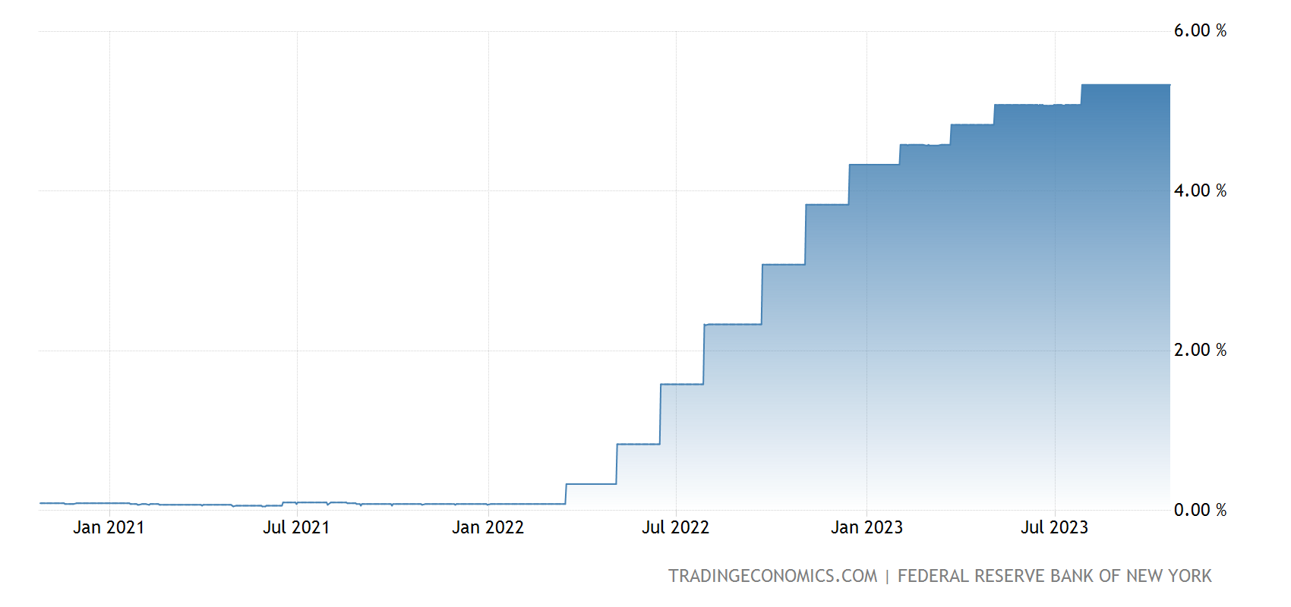
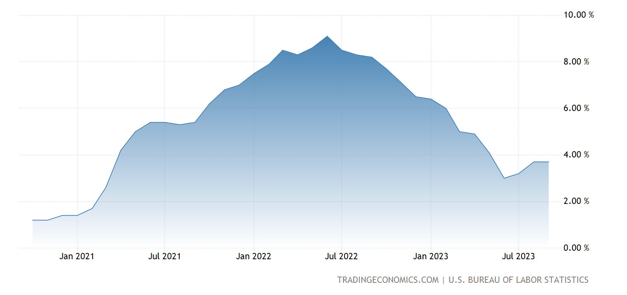
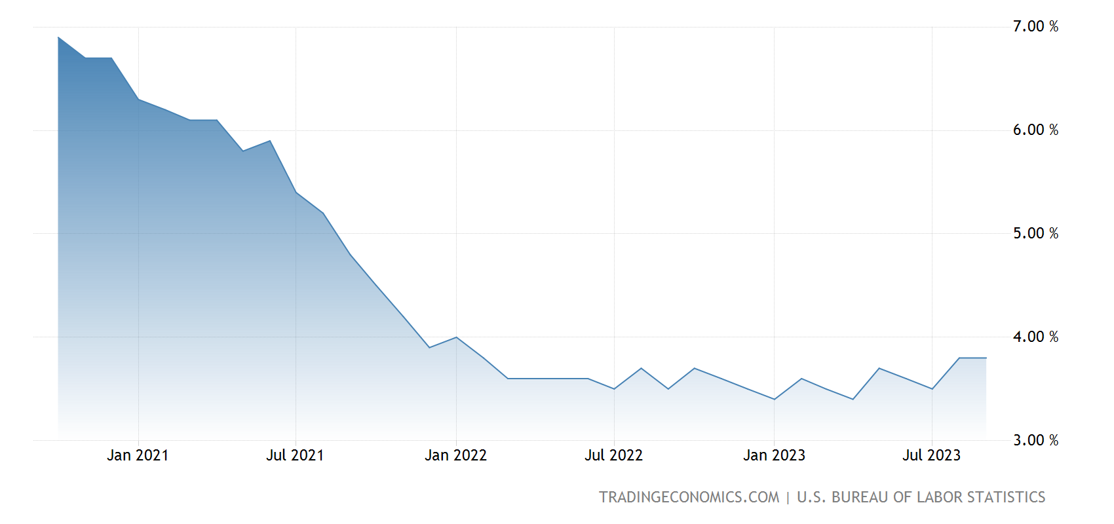
Forces Behind Rising US Interest Rates
Federal Funds Rate
Federal Funds Rate Peaks, Highest in 22 Years
From October 2020 to March 2022, the Federal Funds rate was held at near zero. To curb inflation, the Federal Reserve Board initiated significant rate hikes from March 2022. The Federal Reserve raised the target rates 11 times consecutively over 18 months, reaching a benchmark of 5.25% to 5.5% by July 2023.
The US 10-year Treasury yield, indicative of long-term interest rates, has seen notable increase over the preceding three years. In 2021, the average yield stood at 1.45%, rising to 2.95% in 2022. As of October 2023, the yield has surged to 4.93%, marking a significant increment.
Driver | Observations | Interpretations
Inflation | The inflationary situation in the United States had been on the rise, and was especially severe in 2022 due to global events relating to COVID-19, supply chain disruptions, prior near zero interest rates to stimulate the economy, and the Russia-Ukraine war, inflation peaked at 9.1% in June 2022. | The Federal Reserve’s primary objective it to ensure price stability while maximising employment, with a target inflation rate of 2%. In response to inflationary pressures, it has raised interest rates, bringing it down to 3.7% as of September 2023.
Economy Recovery and Low Unemployment | The US economy exhibited a robust recovery, characterised by remarkable jobs growth that exceeded expectations throughout this period. Despite the rate hikes, unemployment rate has remained below 4% since January 2022, indicating a resilient labour market. | As the job market expanded and unemployment decreased, it signaled a recovering and resilient economy, which typically warrants an increase in interest rates to prevent overheating and control inflation, also leaving more rooms for the Federal Reserve to implement rate hikes.
Inflation Rate
US Unemployment Rate

Slide 9
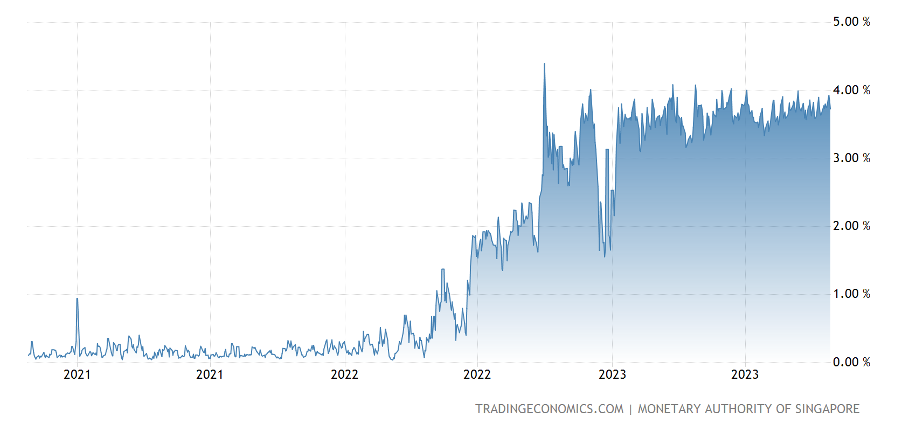
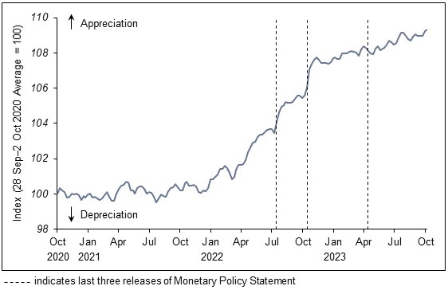
Forces Behind Singapore’s Interest Rates
Singapore Overnight Rate Average
Rising Short-Term and Long-Term Rates
The Singapore Overnight Rate Average (SORA) serves as an indicator of the cost at which financial institutions extend unsecured overnight loans to each other within the Singapore market. The trajectory of the SORA is similar to that of the Federal Funds Rate, but on a diminished scale. It was at near zero levels from October 2020 to March 2022, before escalating sharply to 4% in June 2022, and registered 3.77% as of 25 October 2023.
For the long-term rates, the yield on the Singapore 10-Year Bond has displayed a similar trend. It recorded a yield of 0.67% in October 2020, escalated to 3.62% in October 2022, and after a period of fluctuation settled at 3.39% as of 25 October 2023.
Driver | Observations | Interpretations
SGD Nominal Effective Exchange Rate | The Singapore Dollar Nominal Effective Exchange Rate (S$NEER) serves as the principal monetary policy instrument employed by the MAS. The Index exhibited a range-bound movement around the level of 100 from October 2020 to December 2021. Subsequently, it rose steadily to 110 as of October 2023, indicating an appreciating SGD. | In addressing imported inflation, the Monetary Authority of Singapore (MAS) has thrice adjusted the policy band upwards and steepened its slope since October 2021 to appreciate the Singapore Dollar (SGD), which may have explained the smaller increase in domestic interest rates as compared to global interest rates.
Global Interest Rates | Singapore's interest rate fluctuations exhibit a rising trend similar to global interest rates. Central banks in most developed nations including the European Union, Japan, the UK, and Australia have raised rates since 2022, with some continuing rate hikes in 2023. | As a small and open economy with export 3 times of the GDP, domestic interest rates are heavily influenced by global interest rates and foreign exchange market expectations of the Singapore dollar. Thus we could observe a similar trend of the Singapore interest rates to that of the general rising global trend.
Federal Funds Rate

Slide 10
Investment Considerations for Retail Investors
Navigating a Rising Interest Rate Environment
Understand interest rate impact: Explore how interest rates impact various asset classes. Generally, bond prices fall as interest rates rise, equities may face valuation and cost of capital challenges, while interest sensitive sectors like real estate and utilities will be adversely affected.
Build a diversified portfolio: A well diversified portfolio can help mitigate unsystematic risks associated with rising interest rates. Incorporating a mix of asset classes including commodities may offer a degree of protection against adverse market movements.
Stay informed on market news: Stay updated with market news and likely changes in interest rates. For instance, signs like low inflation, slow economic growth and high unemployment rates may hint at a series of rate cuts. By closely following global interest rates, updates from global central banks and the Monetary Authority of Singapore (MAS), retail investors could gain by correctly spotting trends and adjusting their portfolios accordingly.
Investment Recommendations
Short-Term Bonds
Banks and Brokerages
Cash Rich Companies
Singapore-REITs
Value Stocks
Opting for short-term maturity bonds that are less affected by rate changes or purchasing bonds with coupon rates that adjust alongside market rates.
Higher interest rates boost earnings for banks and brokerages through increased interest income, in an environment where credit is not readily available.
Cash-rich companies, especially large and mature ones benefit from rising rates as they earn more on their reserves, consider companies with low debt-to-equity ratios or substantial cash holdings for potential benefits in such environment.
Some S-Reits are now trading at valuations close to a ten-year low. S-Reits with stable earnings could be undervalued and present investment opportunities, anticipating a potential appreciation in prices when the rate hike cycle ends.
Value stocks are less affected by rate hikes compared to growth stocks, they also rely less on borrowing. Generally, value stocks are more stable in higher interest rates environments.

Slide 11
Thank You!

Slide 12
03

Slide 13
04

Slide 14
Thank you

